Slide 1
Simulation Analysis:
Feedback, Debriefing and Research
Hemda Ben-Yehuda, Luba Levin-Banchik and Chanan Naveh
Prepared by Guy Zohar
When using this presentation, please cite: Ben-Yehuda Hemda, Luba Levin-Banchik, and Chanan Naveh. 2015.
World Politics Simulations in a Global Information Age. Ann Arbor: University of Michigan Press.

Slide 2
Once a simulation round ends…
Remove masks and look at the simulation as objective observer from the outside
Address the simulation developments in retrospect
Conduct an overview to see the big picture
Evaluate outcomes and draw conclusions
Ben-Yehuda, Levin-Banchik, and Naveh. 2015. pp. 113-17

Slide 3
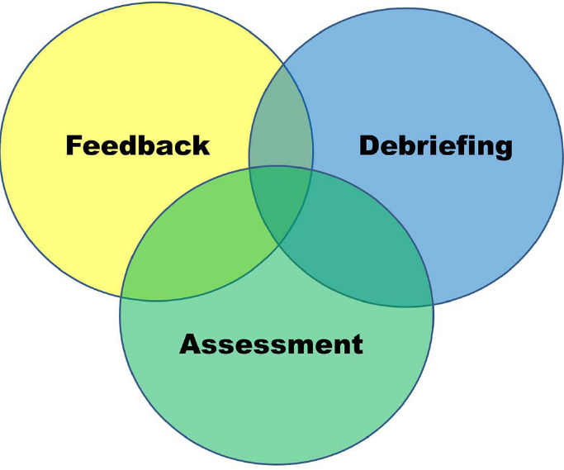
Simulation Overview
Feedback, students’ activities directed by the educator
Debriefing, interactions between students and their educator
Assessment, educator’s activities
Ben-Yehuda, Levin-Banchik, and Naveh. 2015. pp. 113-17

Slide 4
Feedback

Slide 5
Feedback
A learning activity in which each participant
Thinks about matters that emerged during the simulation
Considers goal fulfillment
Provides information and evaluations on topics related to the simulation
Gains a comprehensive overview of the simulation
Evaluates simulation contributions
Ben-Yehuda, Levin-Banchik, and Naveh. 2015. p. 118

Slide 6
Feedback
Efficient feedback helps:
Identify problems and difficulties that emerged during the simulation
Evaluate participants’ contribution to the simulation
Gain ideas about how to improve future simulations

Slide 7
Feedback Guidelines
Get familiar
Study
Complete feedback forms
Follow instructions

Slide 8
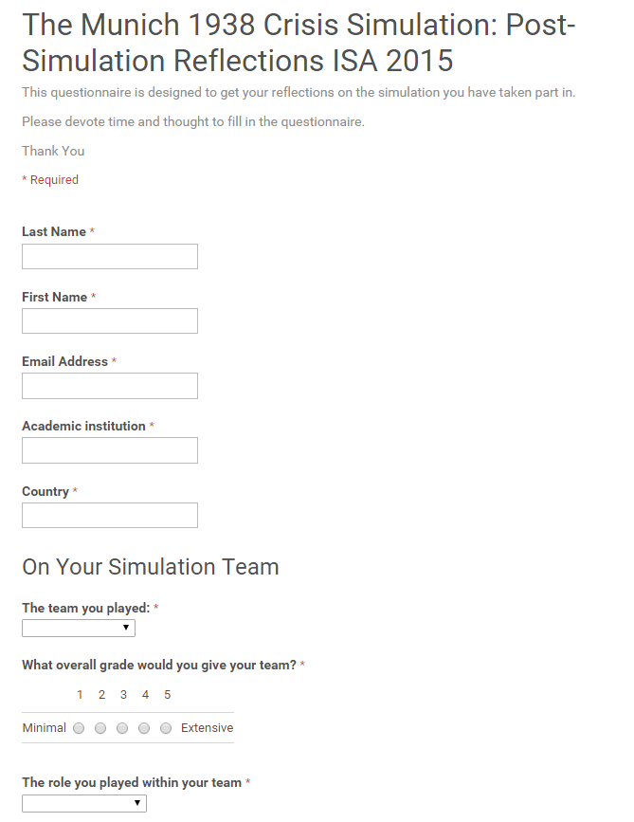
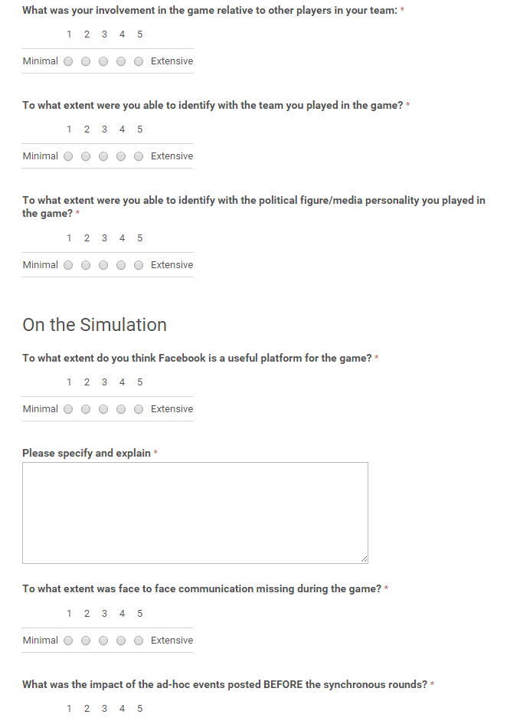
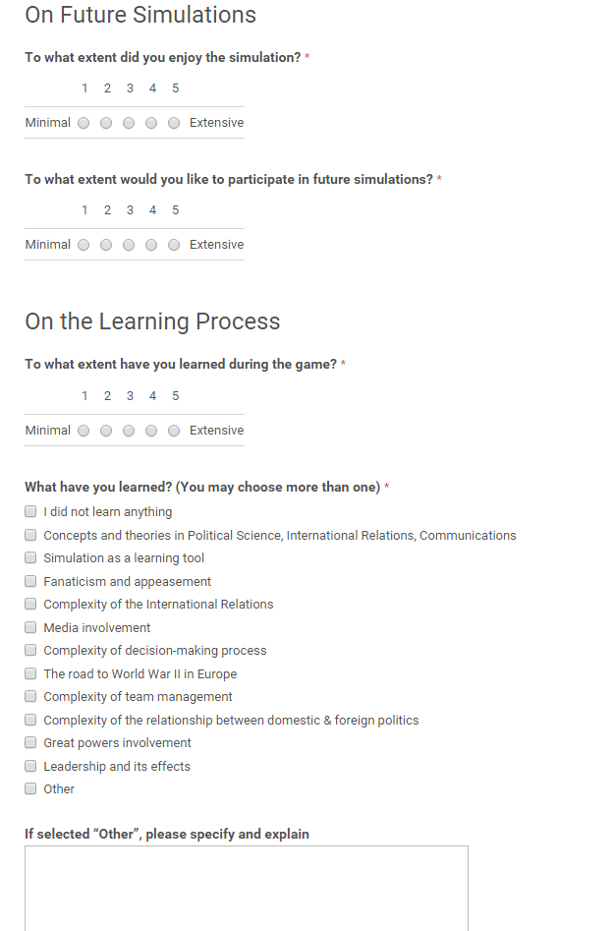
1. Get Familiar
Review forms and read guidelines carefully
Provide feedback individually as a personal reflection on the simulation
Ben-Yehuda, Levin-Banchik, and Naveh. 2015. pp. 123, 131

Slide 9
2. Study
Review your role and activities from four perspectives
As an individual participant
As an assigned character
As part of an assigned team
From an objective outlook on the simulation as a whole
Ben-Yehuda, Levin-Banchik, and Naveh. 2015. p. 131

Slide 10
3.1 Complete Feedback Forms
On all forms:
Registration form
Basic knowledge quiz
Policy formation form
Breaking news poll
Public opinion poll
World politics form
Answer feedback questions
Provide information and evaluations
Add explanations where requested
Ben-Yehuda, Levin-Banchik, and Naveh. 2015. pp. 123, 131

Slide 11
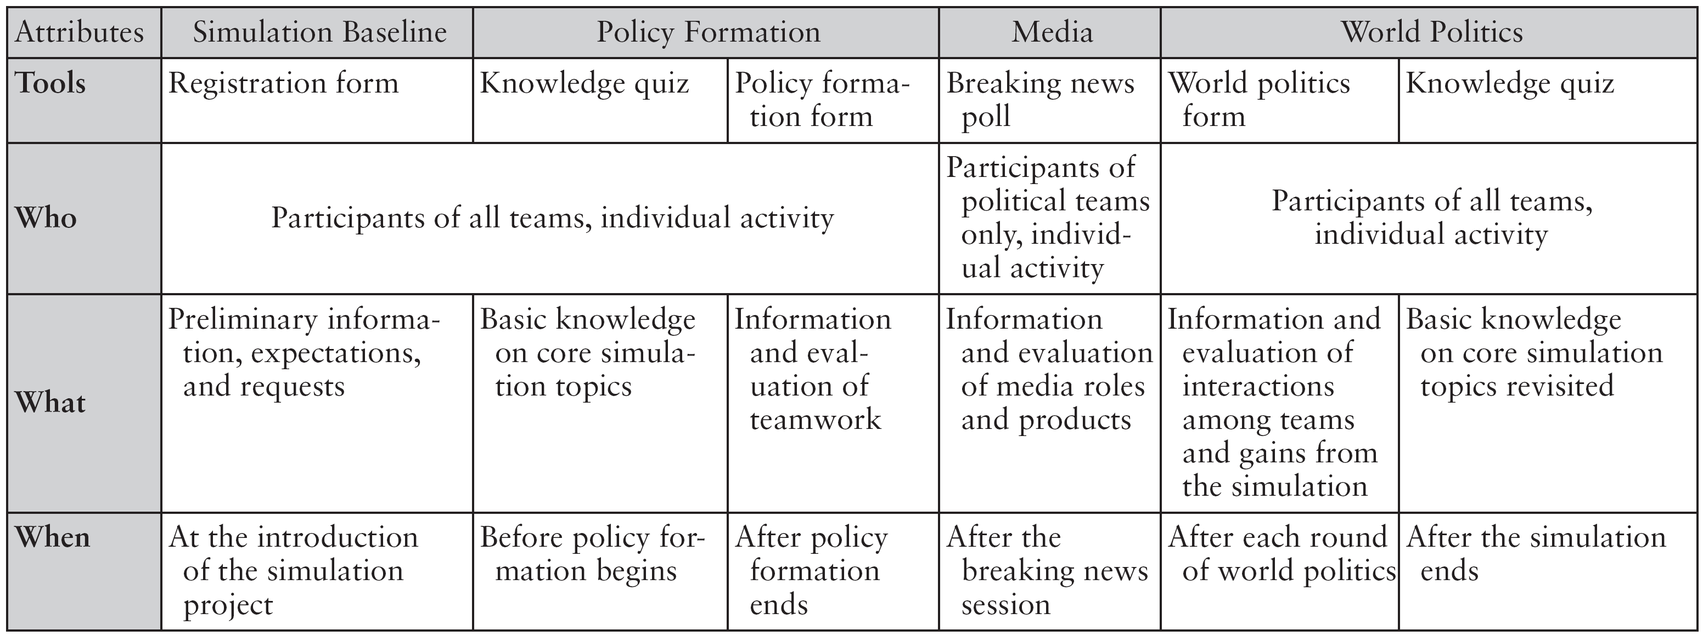
3.2 Feedback Schedule
Feedback is a gradual activity that takes place throughout the simulation project
Ben-Yehuda, Levin-Banchik, and Naveh. 2015. p. 122

Slide 12
4. Follow Instructions
Submit all feedback forms on time
Pay attention to all guidelines to benefit from feedback activities and increase the quality of the debriefing process
Ben-Yehuda, Levin-Banchik, and Naveh. 2015. p. 131

Slide 13
Debriefing

Slide 14
Debriefing
An interactive brainstorming and debate on the simulation
topics
experiences
study efficiency
In debriefing diverse perspectives blend
of each participant
of the educator
of political and media teams
Ben-Yehuda, Levin-Banchik, and Naveh. 2015. p. 132

Slide 15
Debriefing
Summarizes behaviors and contributions of
your own
teammates
other teams
Expose
self-centric approaches
misperceptions
mirror images
prejudices
stereotypes
Ben-Yehuda, Levin-Banchik, and Naveh. 2015. pp. 132-33

Slide 16
Debriefing Guidelines
Get familiar
Study
Participate in the debriefing session
Follow instructions

Slide 17
1. Get Familiar
Study debriefing topics and think about theme questions for discussions
Yours and those raised by the educator, e.g.,
Theoretical and empirical problems
Behavioral paradoxes
Ethical dilemmas
Ben-Yehuda, Levin-Banchik, and Naveh. 2015. pp. 136, 138-39

Slide 18
2.1 Study
Review your role and activities from four perspectives
As an individual participant
As an assigned character
As part of an assigned team
From an objective outlook on the simulation as a whole
Ben-Yehuda, Levin-Banchik, and Naveh. 2015. p. 139

Slide 19
2.2 Study
Efficient debriefing occurs when you
Assemble all the material created during the simulation
Classify and analyze it before the debriefing sessions
Compare it with products generated by others
Ben-Yehuda, Levin-Banchik, and Naveh. 2015. p. 139

Slide 20
2.3 Study
Debriefing topics cover many aspects you have learned throughout the simulation
Theory – usefulness, applicability, robustness, validity
The empirical world – contextual background, core events, turning points
The area and actors dealt by the simulation – regional dynamics, cultural-social complexities
Ben-Yehuda, Levin-Banchik, and Naveh. 2015. p. 132-33

Slide 21
2.4 Study
Did you practice and improve skills?
Information processing
Critical thinking
Strategic planning
Decision-making
Coercive diplomacy
Negotiation and mediation
Media management
Resolving ethical dilemmas
Ben-Yehuda, Levin-Banchik, and Naveh. 2015. p. 133

Slide 22
2.5 Study
Did you feel?
Fun and frustration
Uncertainty and surprise
Stress
Hostility and empathy
Denial and identification
Anger and happiness
Failure and success
Ben-Yehuda, Levin-Banchik, and Naveh. 2015. p. 133

Slide 23
2.6 Study
Did emotions affect your
Decisions
Negotiation
Media management
Simulation outcomes
Does the impact of emotions you have identified in the simulation also occur in the real world?
Ben-Yehuda, Levin-Banchik, and Naveh. 2015. p. 133

Slide 24
2.7 Study
In preparation for debriefing you and your teammates should prepare a team presentation that covers simulation highlights
Relevant data on the actor and its leading characters
Debates on team values, goals, and policy plans
Media strategy
Main difficulties in each round of world politics
Main achievements in each round of world politics
Lessons learned from the simulation project
Suggestions for improvements in future simulations
Ben-Yehuda, Levin-Banchik, and Naveh. 2015. p. 137

Slide 25
2.8 Study
Each team should also prepare an opening speech
Speeches should take approximately 5 minutes and provide
An eyewitness account of a personal encounter
The most important gain of the team
The main difficulty the team confronted
The most important lesson teammates learned
Inputs for change and practical adaptation to
produce better simulations in the future
Ben-Yehuda, Levin-Banchik, and Naveh. 2015. p. 137

Slide 26
3.1 Participate in Debriefing
During the session you should
Listen, think and learn from others
React to arguments and inquiries
Share insights
Raise critical questions
Express creative ideas
Suggest changes and improvements for future simulations
Ben-Yehuda, Levin-Banchik, and Naveh. 2015. p. 139

Slide 27
3.2 Participate in Debriefing
Remember that there are no “right” or “wrong” ideas
Feel free to participate, share your thought and contribute to the discussion
Consider inputs for preparation of assignments and research projects
Integrate the different aspects raised in the debriefing into a comprehensive outlook of the simulation
Ben-Yehuda, Levin-Banchik, and Naveh. 2015. p. 139

Slide 28
4. Follow Instructions
Abide by the debriefing guidelines and schedule
Prepare for, contribute to, and learn from the debriefing sessions
Ben-Yehuda, Levin-Banchik, and Naveh. 2015. pp. 139-40

Slide 29
Simulation as a Research Lab
in Social Science

Slide 30
Research
Simulations are the closest methodological tool that resemble a research lab
Simulations allow
Testing of hypotheses
Creating a database of simulation-generated products
Control of variables
Repeated experiments
Ben-Yehuda, Levin-Banchik, and Naveh. 2015. pp. 116-17

Slide 31
Research Topics
A comparison between
A current/historical case and its counterpart in the simulation
Media in the simulation and the real world
Analysis of interviews with simulation participants to learn from their experience about the impact of
Theory
Event
Media product
Ben-Yehuda, Levin-Banchik, and Naveh. 2015. pp. 117

Slide 32
Simulation Research Project
To promote a simulation research project
Choose a paradigm, theory, or model
Conduct a literature review
List all fundamental assumptions
Check their relevance to the simulation scenarios, actors, and interactions
Decide on variables and hypotheses
Figure out how to test these hypotheses
Come up with operational measures that suit the simulation platform
Ben-Yehuda, Levin-Banchik, and Naveh. 2015. pp. 137

Slide 33
Simulations and Research Tools
Feedback forms can serve as a useful tool to create
a dataset that can be analyzed in both qualitative and quantitative methods
Pre and post simulation forms are especially useful
to detect changes in perceptions and understanding of theoretical concepts that accrued as a result of the simulation project
Ben-Yehuda, Levin-Banchik, and Naveh. 2015. pp. 117, 130

Slide 34
Simulations and Research Tools
As a standalone project or as an innovative supplement for traditional research provide
A dataset of behavior and attitudes, team activities, media products, simulation scenarios and other simulation activities that can be examined by
Qualitative and/or quantitative mode
Events data and/or content analysis methods
Ben-Yehuda, Levin-Banchik, and Naveh. 2015. pp. 117

Slide 35
Questions for Discussion
Who won and why?
Who was the best team in the simulation and why?
Should the simulation reflect reality and did it?
How successful was your team and why?
How important is the personality factor?
Should the simulation alter attitudes and did it?
What did you like more: face-to-face or cyber interactions?
When did you learn more: during face-to-face or cyber interactions?
Can you summarize the simulation in one sentence?

Slide 36
Key Concepts
Feedback forms
Registration forms
Basic knowledge quiz
Policy formation form
Breaking news poll
Public opinion poll
World politics form
Simulation overview
Feedback
Debriefing
Topics for discussion
Theme questions
Team presentations
Opening speeches
Simulation as a research lab

Slide 37
Relevant Figures and Tables
Figure 7.2. Integrated Simulation Overview, page 115
Table 7.1. Simulation Overview, page 114
Table 8.1. Feedback Schedule, page 122
Table 8.7. Instructions for Participants on Feedback, page 131
Table 9.1. Debriefing Schedule, page 135
Table 9.2. Instructions for Participants on Debriefing, page 139
Available online at book’s website under classroom resources

