Slide 1
World Politics
Hemda Ben-Yehuda, Luba Levin-Banchik and Chanan Naveh
Prepared by Guy Zohar
When using this presentation, please cite: Ben-Yehuda Hemda, Luba Levin-Banchik, and Chanan Naveh. 2015.
World Politics Simulations in a Global Information Age. Ann Arbor: University of Michigan Press.

Slide 2
World Politics
A process of rapid action-reaction exchanges
Among states, nonstates actors, international organizations, and media organs
To promote values and goals within a competitive setting

Slide 3
World Politics Guidelines
Get familiar
Participate in interactions among teams
Keep updated
Follow instructions

Slide 4
1.1 Get Familiar
Read the opening scenario and assess its implications
Take new developments into account
Adjust your team plans accordingly
Ben-Yehuda, Levin-Banchik, and Naveh. 2015. pp. 106-7

Slide 5
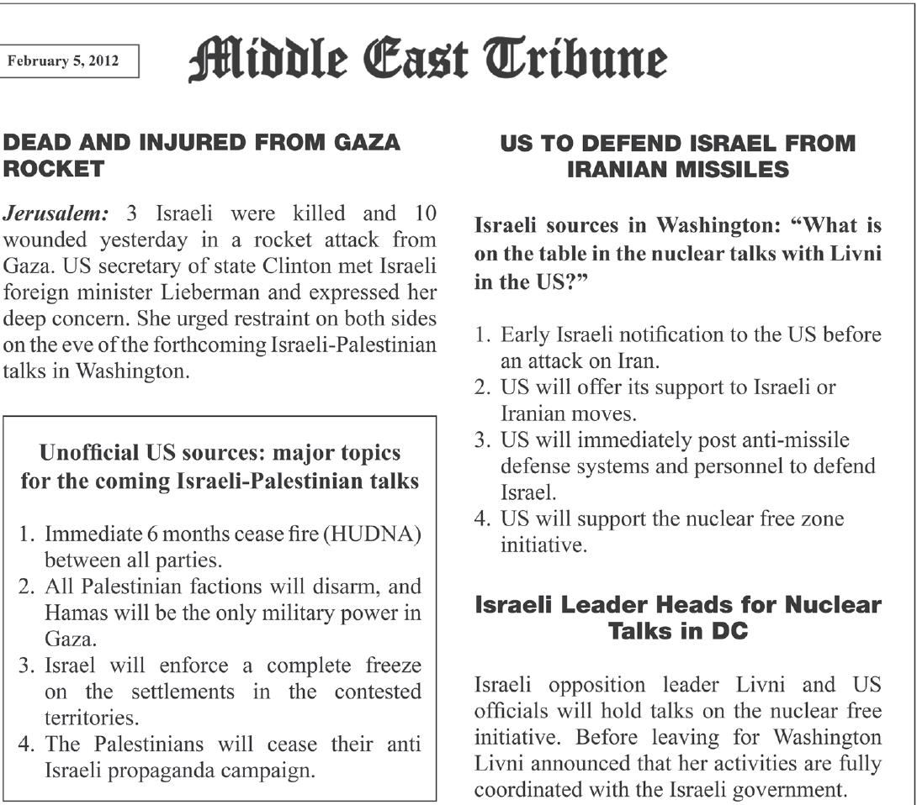
1.3 Get Familiar
2012 Middle East Cyber Simulation
Ben-Yehuda, Levin-Banchik, and Naveh. 2015. p. 91

Slide 6
1.4 Get Familiar
2015 Hybrid Simulation of the 1938 Munich Crisis

Slide 7
2.1 Participate in Interactions among Teams
Each team member:
Interacts with allies and rivals using a variety of policy means, short of war
Performs independently in specialized aspect of the scenario
Follows the main themes of the cohesive team plan decided during policy formation
Ben-Yehuda, Levin-Banchik, and Naveh. 2015. p. 107

Slide 8
2.2 World Politics Tools for Political Teams
Suggest topics for discussions
Offer to serve as mediators
Participate in negotiations
Draft, challenge, accept, sign, reject or modify diplomatic offers, treaties, alliance proposals, or peace plans
Grant/halt economic, humanitarian, or military aid
Threat to use violence or other forms of coercive diplomacy
Issue an ultimatum
Declare a state of emergency, high alert
Move forces or order military buildups
Use terror, hostage taking acts, reprisals and other limited violence, short of war only with the consent of your educator
Ben-Yehuda, Levin-Banchik, and Naveh. 2015. p. 107

Slide 9
2.3 Media Management for Political Teams
Make an impact on the news agenda
Implement a public diplomacy campaign to build a positive image for your team
Publish press releases with official positions
Get interviewed using “sound bites”
React to media publications
Circulate spins and leaks
Share information selectively
Beware of media manipulation
Ben-Yehuda, Levin-Banchik, and Naveh. 2015. p. 95

Slide 10
2.4 World Politics Tools for Media Teams
Gain exposure and set the simulation agenda
Shape the activity between political teams
Get exclusive press releases, interviews and provocative
leaks
Cover developments in short salient breaking news items
Highlight sensational facts colorful “sound bites”, and
emotional pictures
Plan publications for prime time media breaks
Ben-Yehuda, Levin-Banchik, and Naveh. 2015. pp. 95, 107

Slide 11
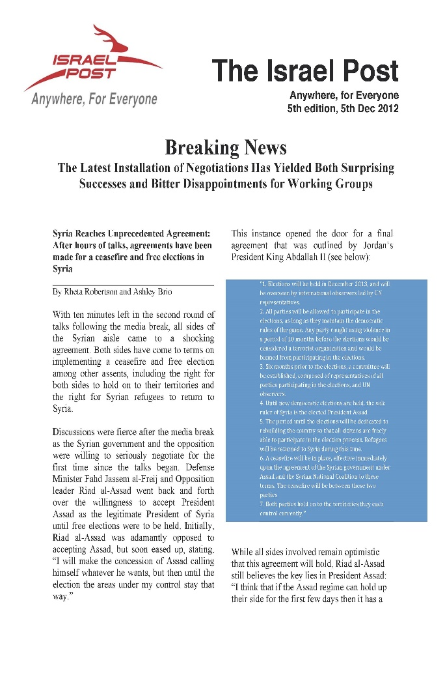
2.5 Media Products
2012 Arab-Israel Conflict Cyber Simulation

Slide 12
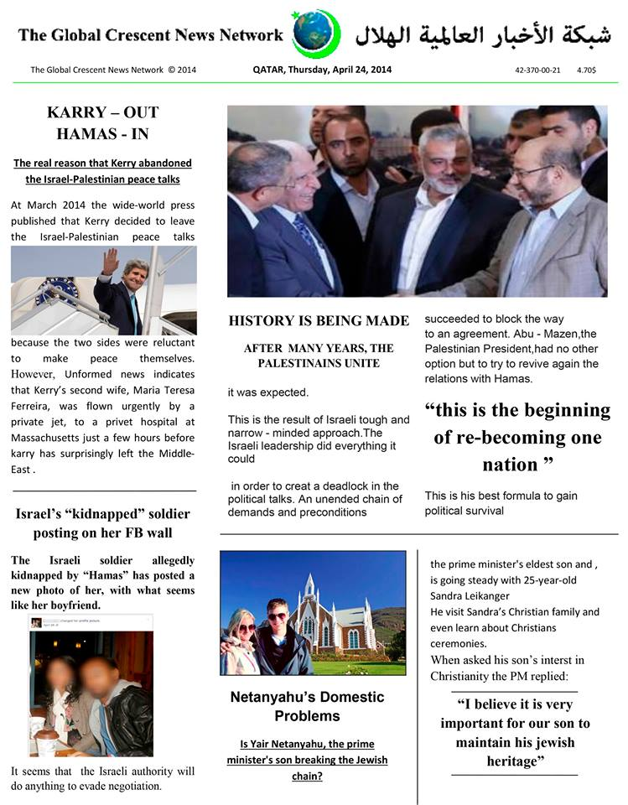
2.6 Media Products
2014 Arab-Israel Conflict Cyber Simulation

Slide 13
2.7 Media Products
2012 Arab-Israel Conflict Cyber Simulation

Slide 14
2.8 World Politics Outcomes
Communicate to find mutually acceptable solutions
Shape the impending agreement in favorable terms
Seek compromise, bypass deadlocks and avoid extreme escalations
Draft a formal document outlining points of agreement
Formulate a summary document of disagreements as a map for future talks
Ben-Yehuda, Levin-Banchik, and Naveh. 2015. p. 108

Slide 15
2.9 Secret Back-channel Activities
Use covert negotiations alongside public interactions
Check reactions to “trial balloons” and test reception of offers for policy transformation
Plan media management: timing for exposure of secret initiatives
Ben-Yehuda, Levin-Banchik, and Naveh. 2015. pp. 96-99

Slide 16
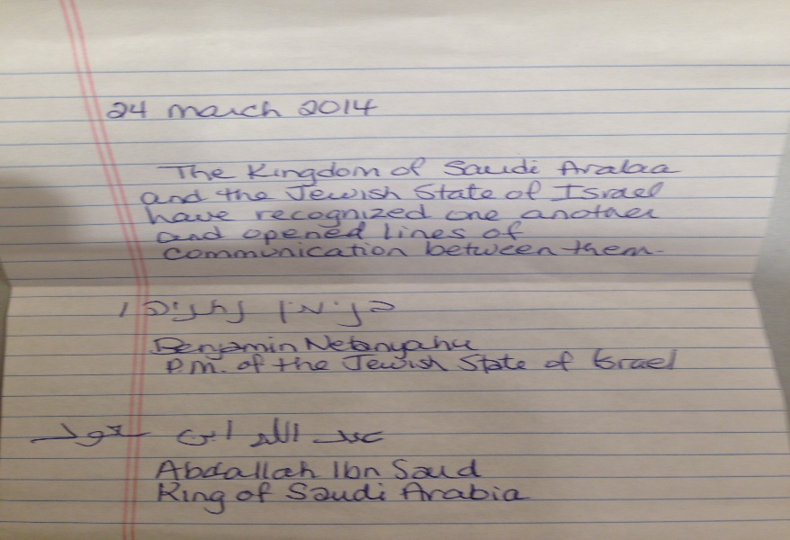
2.10 Back-channel in Face-to-Face Simulations
Negotiations can include an exchange of letters or secret meetings

Slide 17
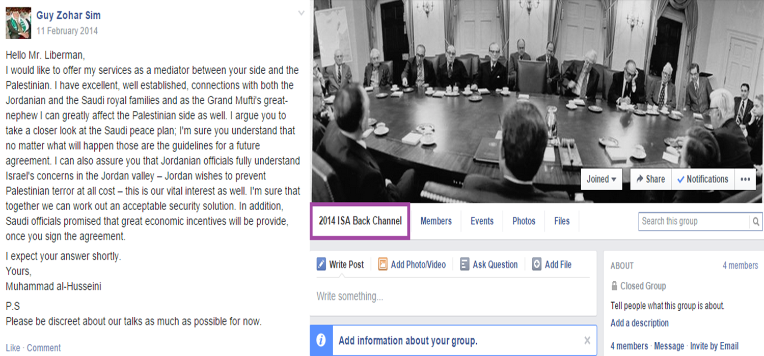
2.11 Back-channel in Cyber Simulations
Ask rival decision-makers to join you for secret talks on a Facebook back-channel group

Slide 18
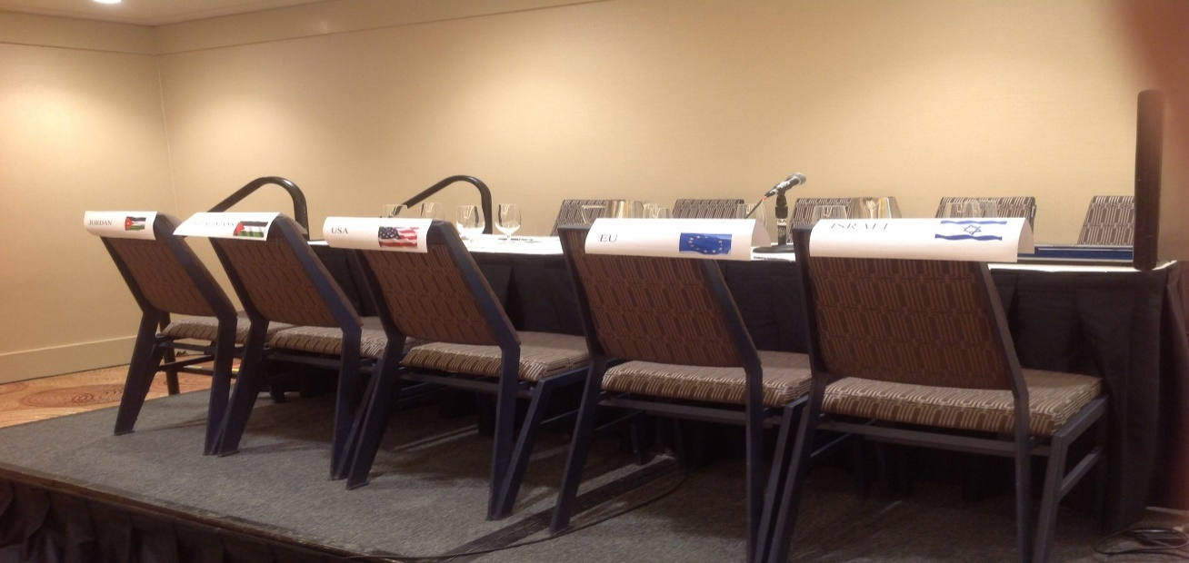
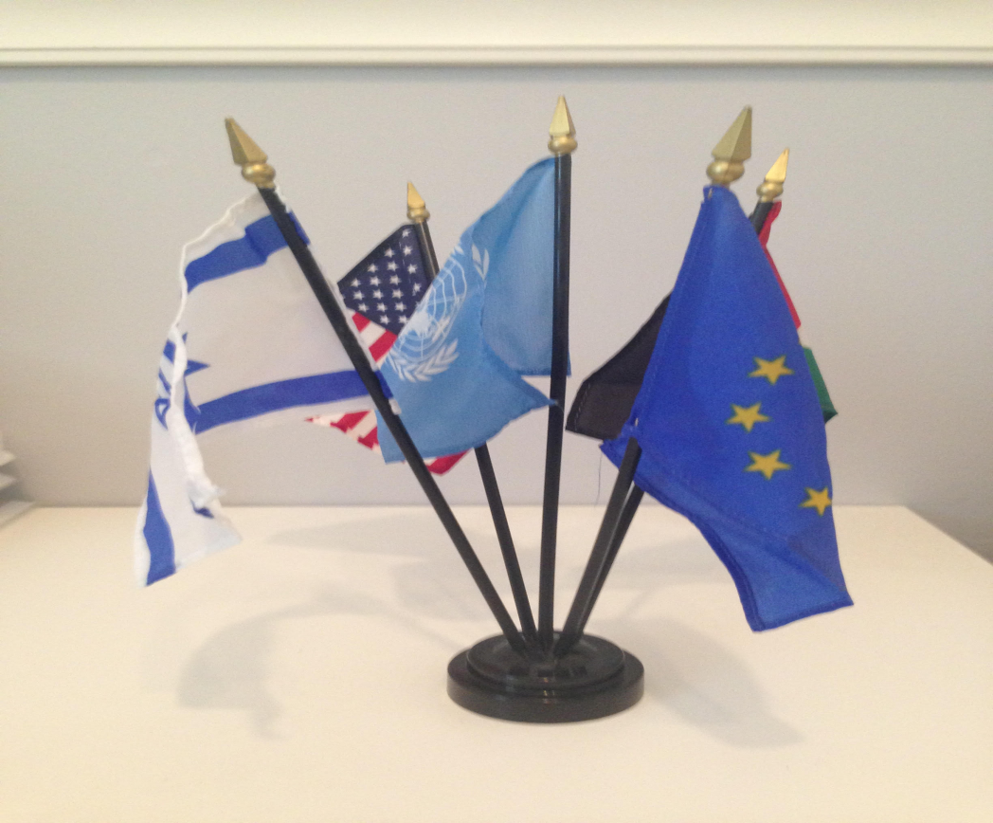
2.12 Atmosphere in World Politics
Trigger lively debates to enrich the simulation experience
Use ethnocentric terminology
Rely on body language, costumes and décor
Ben-Yehuda, Levin-Banchik, and Naveh. 2015. pp. 15, 97, 98

Slide 19
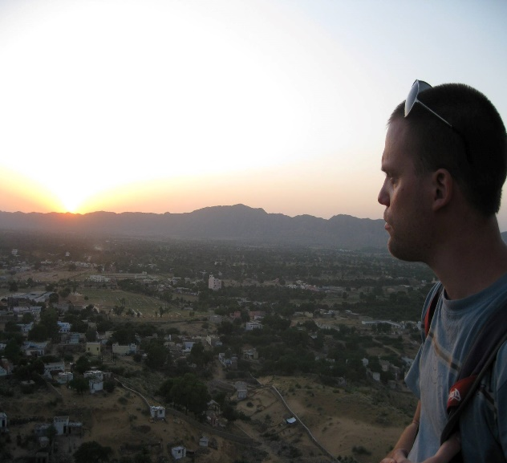
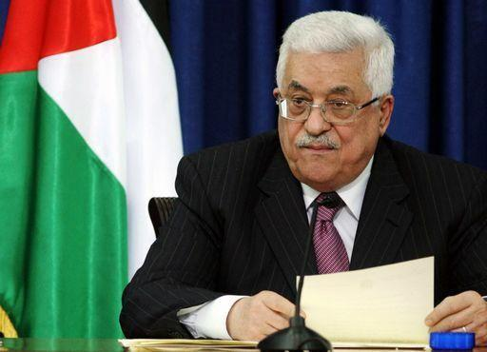
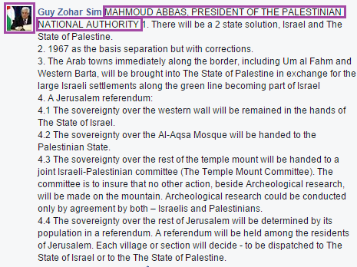
2.13 Character Identification on Facebook
Change your personal profile picture to the character you were assigned for the period of synchronous interactions
Start posts and messages with the name of your character and its role in capital letters
Ben-Yehuda, Levin-Banchik, and Naveh. 2015. pp. 15, 77

Slide 20
3.1 Keep Updated
Keep track of updates provided during the media break
Share and discuss outcomes and media publications with teammates
Coordinate and revise your team’s activities
Ben-Yehuda, Levin-Banchik, and Naveh. 2015. p. 108

Slide 21
3.2 Ad-hoc Events
Ad-hoc events are “mini scenarios” with new and often provocative information
Follow ad-hoc events and take them into account
Consult with teammates about positive and negative implications of ad-hoc events for your team
Reevaluate your policy plans accordingly
Ben-Yehuda, Levin-Banchik, and Naveh. 2015. pp. 93-94

Slide 22
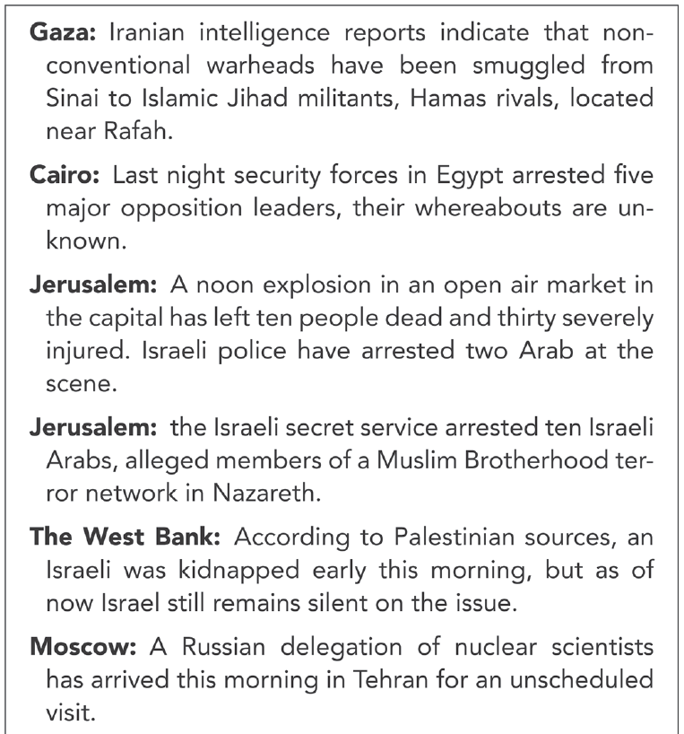
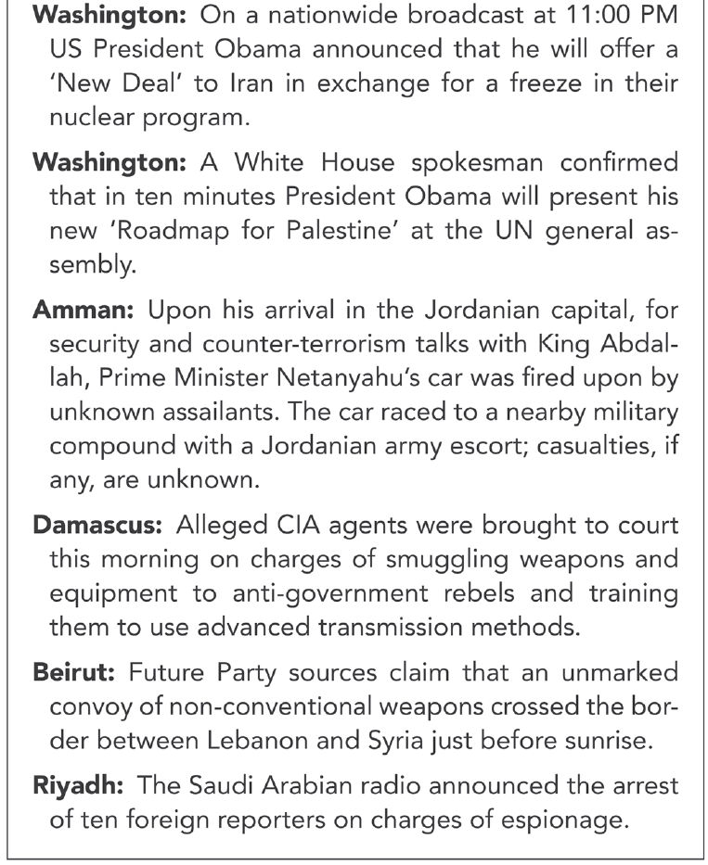
3.3 Examples of ad-hoc events
Ben-Yehuda, Levin-Banchik, and Naveh. 2015. p. 93

Slide 23
3.4 Examples of Ad-hoc Events
2015 Cyber Simulation of the 1947/1948 Palestine Partition

Slide 24
3.5 Examples of Ad-hoc Events
2014 Arab-Israel Conflict Cyber Simulation

Slide 25
3.6 Examples of Ad-hoc Events
2015 Hybrid Simulation of the 1938 Munich Crisis

Slide 26
4. Follow Instructions
Coordinate activities with teammates
Abide by the simulation schedule and rules
Activities at odds with simulation rules will be stopped
Rule breakers risk lower grades
Ben-Yehuda, Levin-Banchik, and Naveh. 2015. p. 108

Slide 27
Questions for Discussion
What are the chances of surprise, unexpected outcomes and turning points in world politics?
Is the option of a back-channel essential?
Why is it necessary to get the educator’s permission before the use of violence in world politics?
Why should you be aware of media manipulation?
What is a successful simulation?
What is more important in world politics: friends or foes?
What should a team do in case of deadlock?
Is compliance always a failure?

Slide 28
Key Concepts
World politics interactions
World politics tools
Media manipulation
Media break
Simulation atmosphere
Ad-hoc event
Policy revision
Back-channel
Negotiation outcomes
Document of agreements/disagreements

Slide 29
Relevant Figures and Tables
Figure 6.1. Scenario Format: French Mediation Plan, page 90
Figure 6.2. Scenario Format: Middle East Tribune, page 91
Figure 6.3. Scenario Format: Multilateral Negotiation Invitations, page 92
Figure 6.4. Scenario Format: Second Israeli News Release, page 92
Figure 6.5. Ad-hoc News Flashes, page 93
Figure 6.6. Gulf Nuclear Simulation Schedule, page 96
Table 6.1. Schedules for World Politics Interactions, page 100
Table 6.2. World Politics Instructions for Participants, page 107
Available online at book’s website under classroom resources

