Slide 1
Policy Formation
Hemda Ben-Yehuda, Luba Levin-Banchik and Chanan Naveh
Prepared by Guy Zohar
When using this presentation, please cite: Ben-Yehuda Hemda, Luba Levin-Banchik, and Chanan Naveh. 2015.
World Politics Simulations in a Global Information Age. Ann Arbor: University of Michigan Press.

Slide 2
Policy formation involves decision-making and teamwork among participants within political and media teams
It requires teammates to discuss and decide on their collective actor profile, values, goals and policy plan
Policy formation is essential for transforming individuals into a team with a coherent policy

Slide 3
Policy Formation Guidelines
Get familiar
Study
Participate in policy formation
Follow instructions

Slide 4
1.1 Get Familiar
Read the initial scenario and assess its positive and negative meanings from the perspective of your
Team
Character
Study the empirical setting, fictional, historical or current
Look for historical analogies as a useful way to get familiar with the situation at hand
Ben-Yehuda, Levin-Banchik, and Naveh. 2015. p. 85

Slide 5
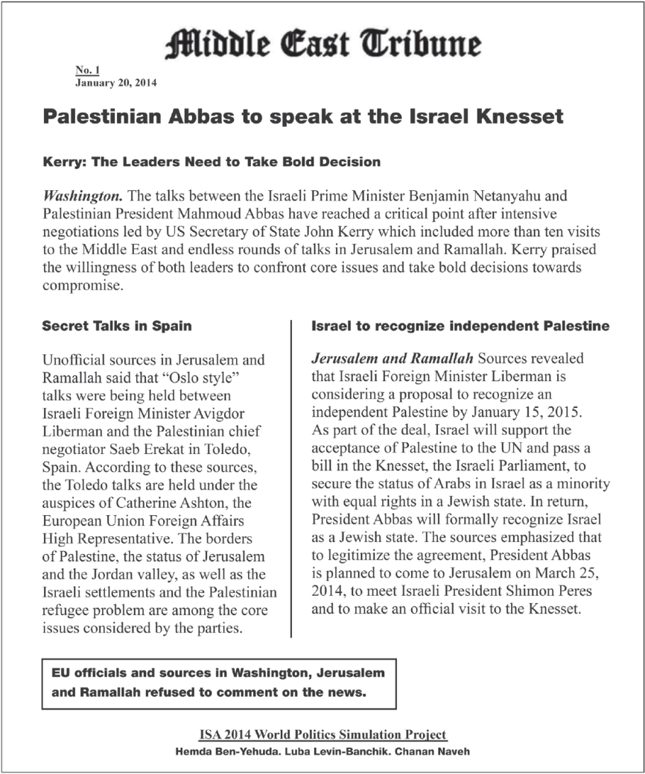
1.2 Get Familiar
2014 Arab-Israel Conflict Hybrid Simulation
Ben-Yehuda, Levin-Banchik, and Naveh. 2015. p. 72.

Slide 6
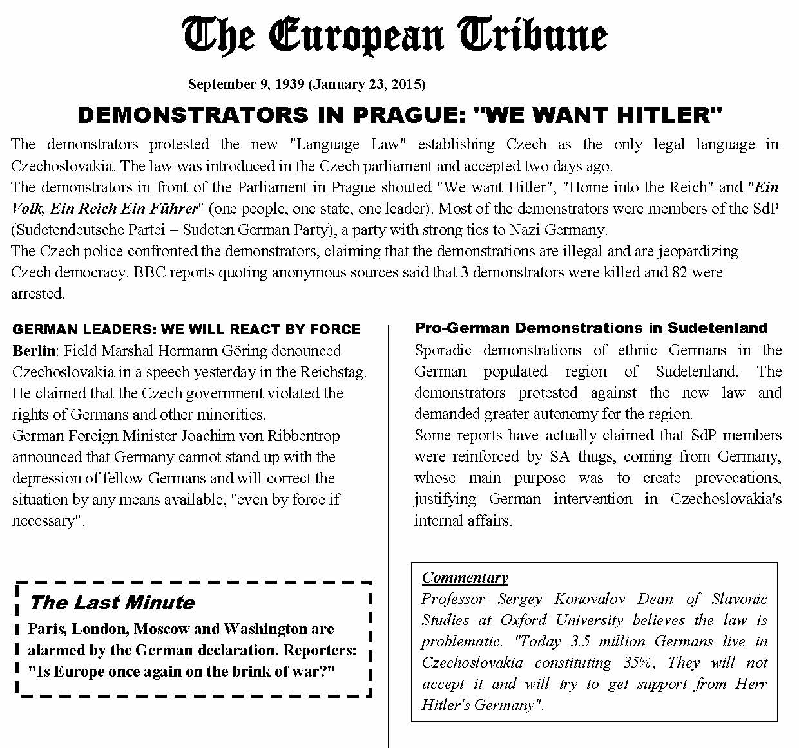
1.3 Get Familiar
2015 Hybrid Simulation of the 1938 Munich Crisis

Slide 7
2.1 Study
Integrate your knowledge on the actor and character with details provided in the scenario
Consider updates for your team’s values, goals and policy plans in light of the scenario
Ben-Yehuda, Levin-Banchik, and Naveh. 2015. p. 85

Slide 8
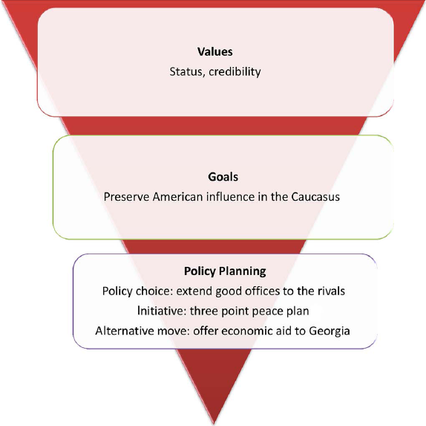
Gradual Policy Formation
Ben-Yehuda, Levin-Banchik, and Naveh. 2015. p. 81

Slide 9
2.2 Policy Formation: Discuss and Decide
Core actor attributes
Actor values and goals
Policy plans and initiatives
Ben-Yehuda, Levin-Banchik, and Naveh. 2015. p. 86

Slide 10
2.3 Actor Profile
Transform individually prepared actor portfolio and all character biographies into a single file
Share, compare, and discuss findings with your teammates
Reach consensus on relevant information
Ben-Yehuda, Levin-Banchik, and Naveh. 2015. p. 80

Slide 11
2.4 Actor Values
Core beliefs that:
Shape the actor’s worldview
Include ideological and normative precepts
Guide actors
Are rarely forsaken
Identify your actor’s values
Rank them
Discuss the relationships between them
Ben-Yehuda, Levin-Banchik, and Naveh. 2015. pp. 80-81

Slide 12
2.5 Actor Goals
Operational stakes:
An actor wants to accomplish
Require allocation of resources
Stem from core values
Related to events in the scenario
Clarify your actor’s goals
Rank them
Discuss the relationship between them
Ben-Yehuda, Levin-Banchik, and Naveh. 2015. pp. 81-82

Slide 13
2.6 Actor Policy Plans and Initiatives
Policy Plans
Most suitable policy measures and initiatives
Relate to each of the goals
Reflect the perspective of your team
Initiatives
A document with offers and/or threats
Translate your team’s decisions into operational acts
Alternative Moves
A second-best choice to reach team’s goals
Ben-Yehuda, Levin-Banchik, and Naveh. 2015. p. 82

Slide 14
3.1 Participate in Policy Formation
Each team member should
Initiate a dialogue with teammates and comment on their remarks
Evaluate and argue with others on their findings and suggestions
Add resources and integrate diverse perspectives
A joint team position is reached by a vote or by the decision of the team leader
Ben-Yehuda, Levin-Banchik, and Naveh. 2015. pp. 85-86

Slide 15
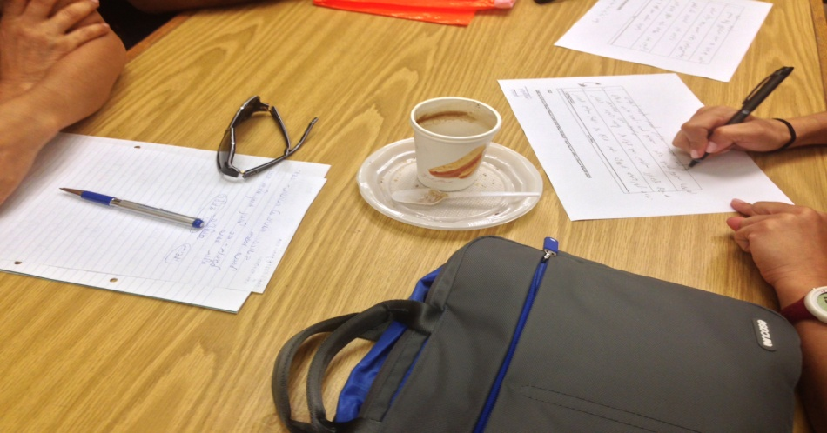
3.2 Face-to-Face Policy Formation
Policy Formation in the 2013 Gulf Nuclear Simulation
Make sure to record discussions for later use!
Ben-Yehuda, Levin-Banchik, and Naveh. 2015. pp. 77-79

Slide 16
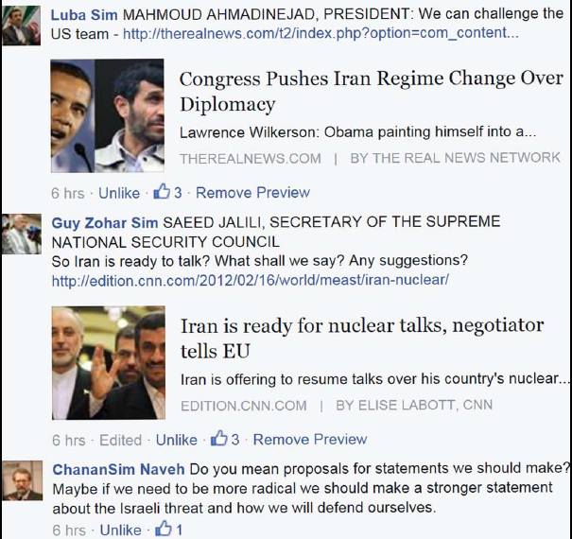
3.3 Cyber Policy Formation
The Iranian team in the 2012 Middle East Cyber Simulation
On social networks you can interact with teammates 24/7
Ben-Yehuda, Levin-Banchik, and Naveh. 2015. pp. 76-77

Slide 17
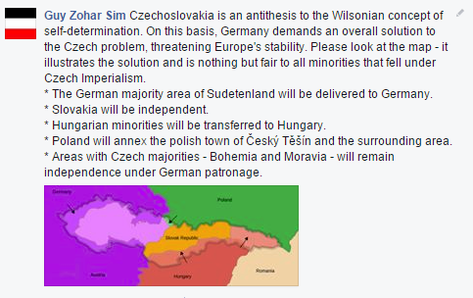
3.4 Initiatives
German team initiative in the 1938 Munich Cyber simulation
Ben-Yehuda, Levin-Banchik, and Naveh. 2015. pp. 76-77

Slide 18
Media Management for Political Teams 3.5
Plan a strategy toward the media
Debate the public image your team wants to create
Use the media to maximize goals
Publish short press releases and get interviewed, incorporate “sound bites” to gain media coverage
Beware of media manipulation
Ben-Yehuda, Levin-Banchik, and Naveh. 2015. p. 76

Slide 19
Policy Formation by Media Teams 3.6
Discuss the products you will publish
Plan the publication schedule and prepare for the media break as a prime time media session
Initiate interviews with political leaders
Take competing media teams into account to gain rating
Preparation of media products at this stage helps the team cope with time pressure and reporting challenges during intensive world politics negotiations
Ben-Yehuda, Levin-Banchik, and Naveh. 2015. p. 76

Slide 20
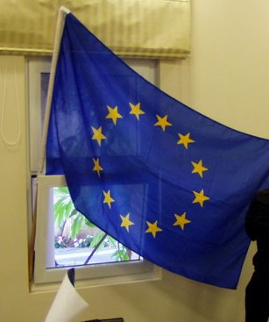
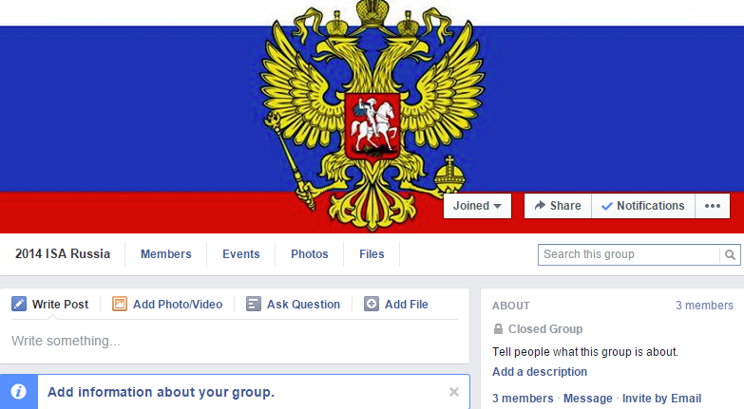
3.7 Atmosphere in Policy Formation
Authentic atmosphere
Enriches the simulation experience
Brings characters and teams to life
Use ethnocentric rhetoric
Decorate your team’s space with national flags, maps, insignia and emblems
Ben-Yehuda, Levin-Banchik, and Naveh. 2015. pp. 15, 77

Slide 21
4.1 Follow Instructions
Abide to simulation rules
Follow proper modes of conduct
Adhere to assigned paradigms and theories
Act according to details and logic of the empirical topic
Get the consent of your educator for violent initiatives
Adhere to team decisions when interacting with others
Cease negotiations during the media break
Use one primary platform for cyber activities
Back up all communications
Keep schedule in mind and hand assignments on time
Ben-Yehuda, Levin-Banchik, and Naveh. 2015. pp. 73-75

Slide 22
Questions for Discussion
Why is policy formation important?
How can regime type influence policy formation?
How does leadership affect intra-team decision-making?
Are policy initiatives based on knowledge or intuition?
Must the team agree on all policy measures?
What are your expectations from allies and rivals?
How can you use the media to promote your team’s values, goals and plans?
What happens when simulation rules are violated?

Slide 23
Key Concepts
Policy formation
Initial scenario
Discuss and decide
Coherent policy
Teamwork
Values, goals, policy plans
Initiatives and alternative moves
Simulation atmosphere
Simulation rules

Slide 24
Relevant Figures and Tables
Figure 5.3. Scenario Format: Middle East Tribune, 2011 page 72
Figure 5.4. Scenario Format: Middle East Tribune, 2014 page 72
Figure 5.5. Scenario Format: U.S. Intelligence Report, page 73
Figure 5.6. Scenario Format: First Israeli News Release, page 73
Figure 5.7. Iranian Policy Formation, page 77
Figure 5.8. Initiatives in the Middle East Simulation, page 78
Figure 5.9. Gradual Policy Formation, page 81
Figure 5.10. Values and Policy, page 83
Table 5.2. Policy Formation Instructions for Participants, page 85
Available online at book’s website under classroom resources

