Slide 1
Simulation Preparations
Hemda Ben-Yehuda, Luba Levin-Banchik and Chanan Naveh
Prepared by Guy Zohar
When using this presentation, please cite: Ben-Yehuda Hemda, Luba Levin-Banchik, and Chanan Naveh. 2015.
World Politics Simulations in a Global Information Age. Ann Arbor: University of Michigan Press.

Slide 2
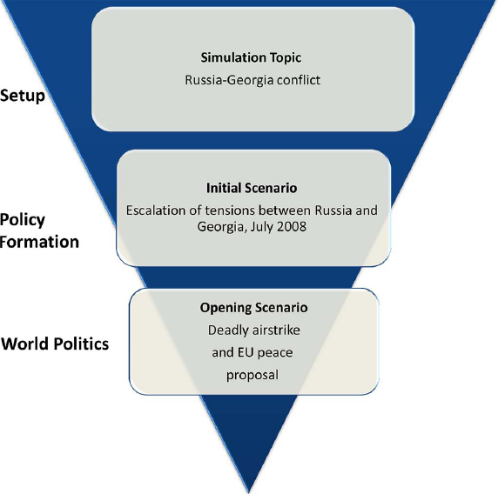
Simulation Stages
Ben-Yehuda, Levin-Banchik, and Naveh. 2015. p. 71

Slide 3
What have been done so far?
Selection of simulation type and topic
Assignment of teams and roles
What next?
Preparation for the simulation
Individuals
Teams

Slide 4
Preparation Guidelines
Get familiar
Study
Follow instructions

Slide 5
Get Familiar
Use simulation website to learn about
Simulation plan, schedule, topic, teams, assignments
Ben-Yehuda, Levin-Banchik, and Naveh. 2015. pp. 58-59, 64-65

Slide 6
2. Study
Conduct research and compose
Actor portfolio
for your political or media actor
Character biography
for your assigned decision-maker or media professional

Slide 7
Individual Assignment: Actor Portfolio
Ten-page report with two parts
First: Description of the actor and its core attributes
Regime type
Ideology
Capabilities and status
Membership in regional/international organizations
Allies and rivals
Values and goals
Policy and behavior
Ben-Yehuda, Levin-Banchik, and Naveh. 2015. pp. 54-57

Slide 8
Individual Assignment: Actor Portfolio
Ten-page report with two parts
Second: Actor’s perspective on simulation topic
The main issues as the actor defines them
A basic timeline of core events
Relevant documents and agreements
Relationships between main actors
Constraints and opportunities the actor should consider
Ben-Yehuda, Levin-Banchik, and Naveh. 2015. pp. 54-57

Slide 9
Individual Assignment: Character Biography
One-page summary
Description of characters’ core attributes: Decision-makers or media professionals
Role
Values
Ideology
Past experience
Main issues as the character defines them
Political rivals
Popularity
Ben-Yehuda, Levin-Banchik, and Naveh. 2015. p. 56

Slide 10
Team Assignment: Collective Actor Portfolio
All teammates
Discuss and decide:
Individual actor portfolios
Character biographies
Compile:
A collective actor portfolio, to guide
Intra-team policy formation
Inter-team world politics interactions
Ben-Yehuda, Levin-Banchik, and Naveh. 2015. p. 80

Slide 11
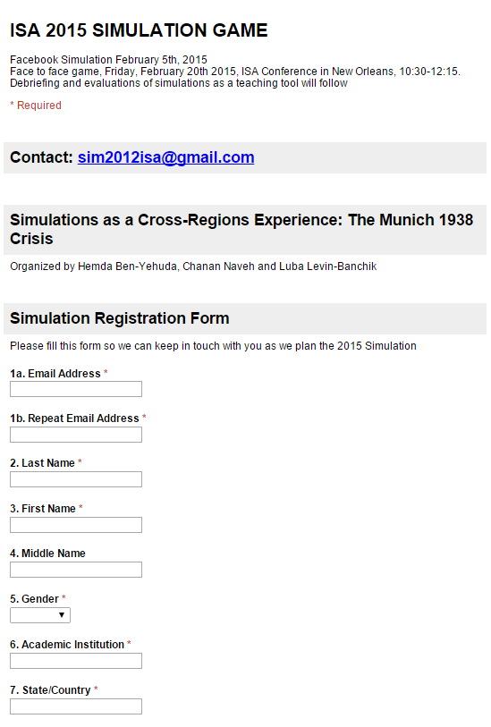
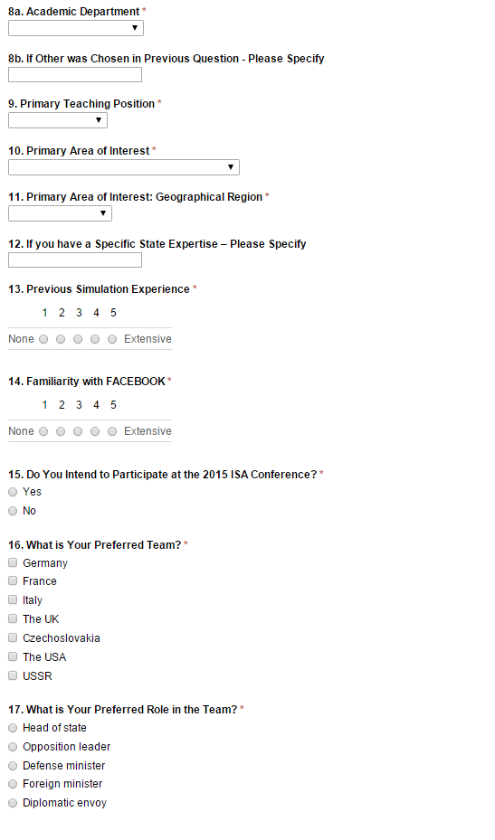
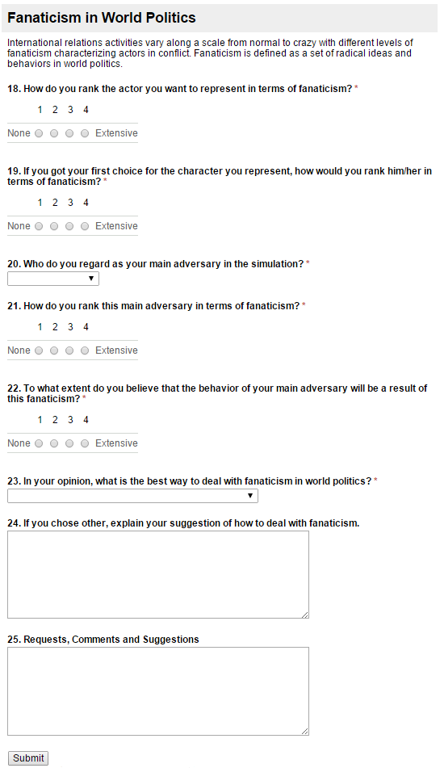
3.1 Follow Instructions
Fill out the registration form
Ben-Yehuda, Levin-Banchik, and Naveh. 2015. pp. 60-61, 62

Slide 12
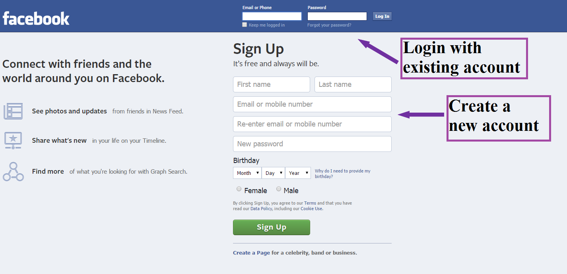
3.2 Follow Instructions
On a virtual platform make sure you are registered to the simulation network
e.g. on Facebook, login to your personal account or create a new one
Ben-Yehuda, Levin-Banchik, and Naveh. 2015. p. 60

Slide 13
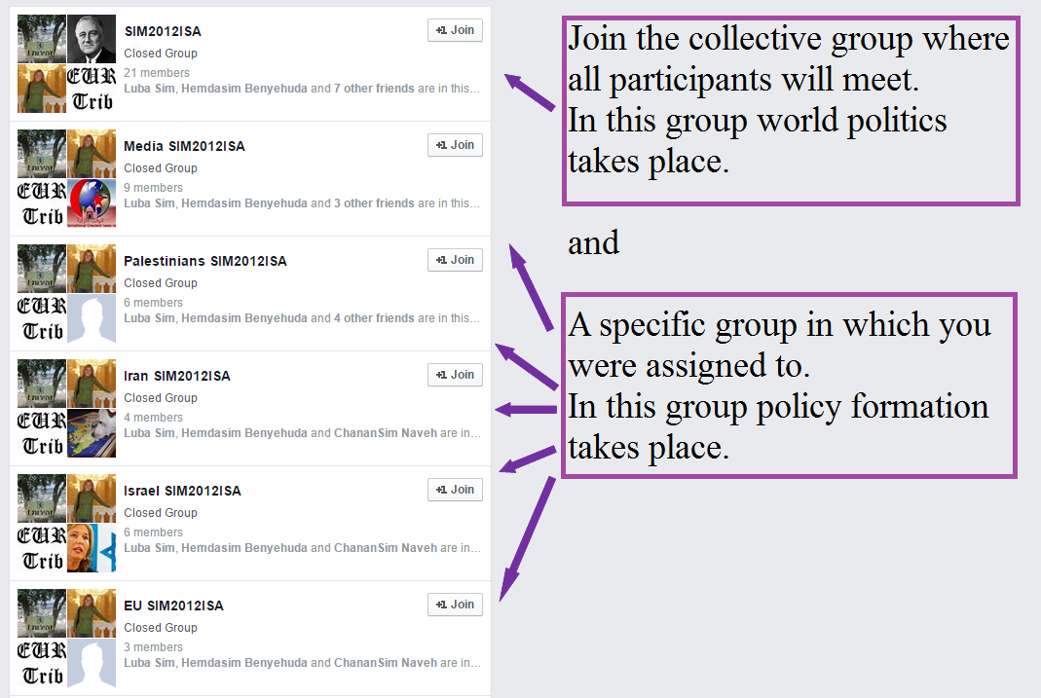
3.3 Follow Instructions
Join assigned simulation groups
Remember: Policy formation and world politics take place in
different “virtual rooms”
Join both of them!
Ben-Yehuda, Levin-Banchik, and Naveh. 2015. p. 60

Slide 14
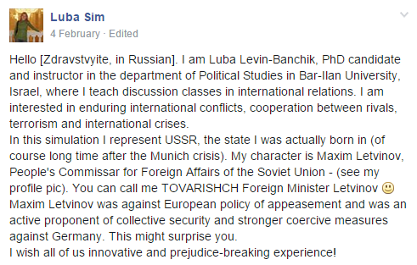
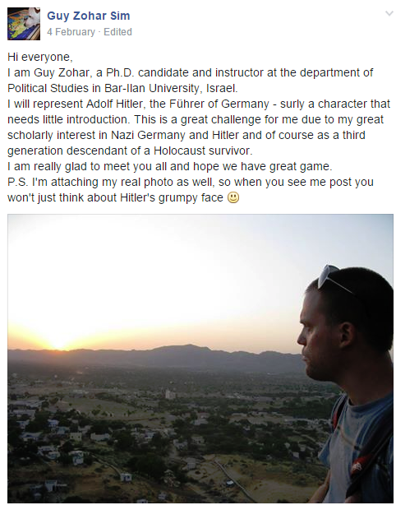
3.4 Follow Instructions
Introduce yourself, your assigned character and role
Add photos and links for additional information
Ben-Yehuda, Levin-Banchik, and Naveh. 2015. p. 65

Slide 15
3.5 Follow Instructions
The simulation is based on gradual learning and step-by-step preparations
The schedule and rules apply to all
Hand in assignments on time
Progressively contribute to your team’s debates on policy formation
Collect information
Exchange ideas
Begin discussions on values, goals and policy
Provide critique
Ben-Yehuda, Levin-Banchik, and Naveh. 2015. p. 65

Slide 16
Questions for Discussion
Why are policy formation and world politics conducted in separate rooms?
What is the difference between individual and collective actor portfolios? Do we need both?
Why should simulations include media actors?
Are simulation rules necessary? What rules would you suggest?
Should simulation rules reflect reality?

Slide 17
Key Concepts
Actor portfolio
Collective actor portfolio
Character biography
Individual and team assignments
Simulations website
Registration form
Intra-team policy formation
Inter-team world politics interactions

Slide 18
Relevant Figures and Tables
Figure 4.1. Simulation Website, page 59
Figure 4.2. Simulation Page on Facebook, page 61
Figure 4.3. Registration Form, page 62
Table 4.3. Simulation Assignments, page 55
Table 4.4. Setup Instructions for Participants, page 64
Available online at book’s website under classroom resources

