Slide 1
Simulations as a Useful Teaching Tool
Hemda Ben-Yehuda, Luba Levin-Banchik and Chanan Naveh
Prepared by Guy Zohar
When using this presentation, please cite: Ben-Yehuda Hemda, Luba Levin-Banchik, and Chanan Naveh. 2015.
World Politics Simulations in a Global Information Age. Ann Arbor: University of Michigan Press.

Slide 2
Why read about a historical event when you can re-create it?
Why learn passively about political and media characters when you can step into their shoes?
Why struggle to understand world politics complexities when you can take part in them?
Learn with a fun, interactive and innovative tool!
Go for it – Start Using Simulations!

Slide 3
Ben-Yehuda, Levin-Banchik, and Naveh
A political system
Set up intentionally
To replicate fiction or nonfiction situations
Involves at least two participants
Individuals or teams,
Representing states, nonstate actors, international organizations, or media organs
Interacting according to a given scenario
Within a present time frame
And specific rules for activity
Simulation
Ben-Yehuda, Levin-Banchik, and Naveh. 2015. p. 13

Slide 4
Simulation Types
Simulations are classified by Players and Environment.
Players
Human – students, professionals and practitioners
Machine – robot interactions structured by pre-preinstalled formula/software
Environment
Physical – concrete location, classroom/lab
Virtual – abstract, non-nontangible milieu
Ben-Yehuda, Levin-Banchik, and Naveh. 2015. pp. 30-32

Slide 5
Simulation Types
Face-to-Face
Human participants
Physical environment
Cyber
Human participants
Virtual environment
Hybrid
Two rounds or more
Face-to-face, on campus
Cyber, on the web
Ben-Yehuda, Levin-Banchik, and Naveh. 2015. pp. 30-32

Slide 6
Simulation Typology
Environment
Players
Physical
&Virtual
Physical
Virtual
Hybrid:
Face-to-Face
& Cyber
Human
Face-to-Face
Cyber
Machine
Software
Cyber Software to Software
Human
& Machine
Human
& Software
Cyber Human
& Software
Complex

Slide 7
Simulation Variations
Course subject
Empirical, theoretical, area studies, methodology
Course duration
Single lesson, semester, year
Class
Size and academic level
Simulation scenario
Historical, contemporary, fictional
Ben-Yehuda, Levin-Banchik, and Naveh. 2015. pp. 23-29

Slide 8
Are Simulations a Useful Teaching Tools?

Slide 9
Study Differently: Cognitive Simulation Utility
Apply, explore, and understand
paradigms, theories, and complexity
underlying processes and causal mechanisms
Change abstract to tangible
international relations, political studies, history, media
concepts and theories come to life
Enter a social science lab to learn more about
decision-making, negotiations, journalism as subjects
practical training
research
Increase levels of study
active learning process
Ben-Yehuda, Levin-Banchik, and Naveh. 2015. pp. 12, 21-22, 146-48, 159-60

Slide 10
Practice & Develop Skills: Behavioral Simulation Utility
Critical thinking and analytical skills
Laboratory for practical training and research on decision making, negotiations, journalism and other topics
Information management and retention
Peer-based collaborative teamwork
Civic culture and rhetoric skills
Ben-Yehuda, Levin-Banchik, and Naveh. 2015. pp. 12, 21-22, 146-48, 159-60

Slide 11
Feel & Enjoy: Affective Simulation Utility
Diversity of cultural, ethical and religious issues, value judgments, prejudice and subjective points of view
Sympathy, empathy, identification and attitude modifications
Creativity and improvisation to make learning emotional, intensive and fun
Ben-Yehuda, Levin-Banchik, and Naveh. 2015. pp. 12, 21-22, 146-48, 159-60

Slide 12
Traditional learning
vs.
Hybrid learning with simulations

Slide 13
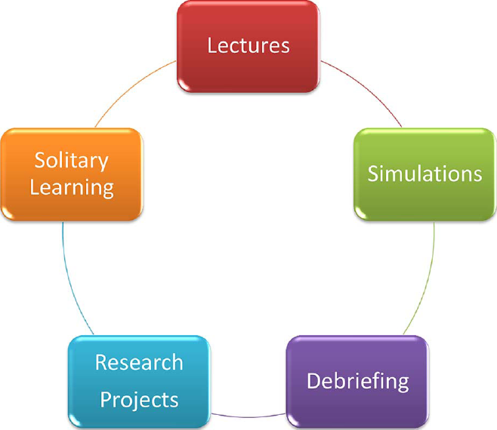
The Hybrid Learning Cycle
Ben-Yehuda, Levin-Banchik, and Naveh. 2015. p. 11

Slide 14
Passive Learning Replaced
Traditional learning
Knowledge is transferred by the educator to the students
Students are generally passive followers
Hybrid learning with simulations
Knowledge is transferred
educator to the students
students to peers
students to educator
Students partake in an active learning process
Ben-Yehuda, Levin-Banchik, and Naveh. 2015. p. 7

Slide 15
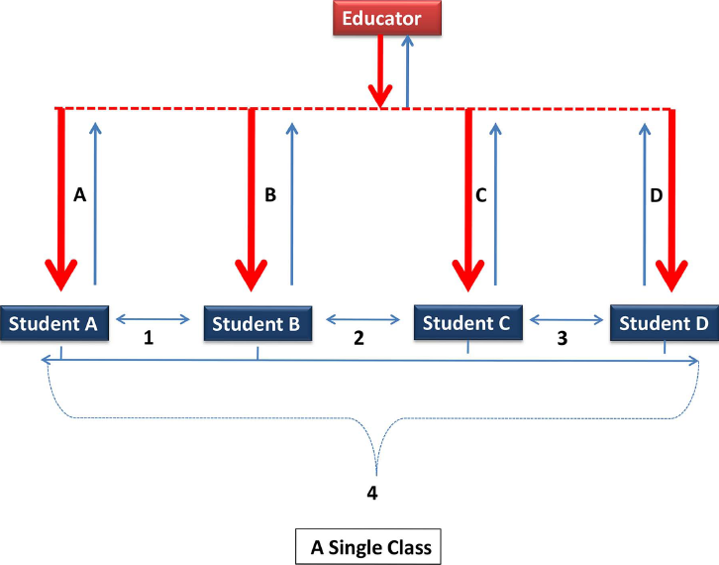
The Transformed Learning Structure
Restructuring of the learning configuration:
From a traditional top-down one illustrated by the bold red arrows alone,
to a more complex one, shown by the addition of multiple light blue arrows
Ben-Yehuda, Levin-Banchik, and Naveh. 2015. p. 7

Slide 16
Solitary Learning Transformed
Traditional learning
The learning process is prefixed
Assignments as solitary tasks: reading texts, and written essays
Hybrid learning with simulations
Active participation of each student
Interactions between students and educator
Interactions among peer students
Assignments shaped by educator with individual initiatives as opportunities for creativity and cooperation
Ben-Yehuda, Levin-Banchik, and Naveh. 2015. pp. 7-8

Slide 17
Traditional Resources Expanded
Traditional learning
Academic content and textbooks, mostly available at the library
Sharing resources and debating them is limited
Hybrid learning with simulations
Unlimited resources: traditional and cyber, such as photos, videos, and documents, available online with easy access
Sharing resources online makes discussions on their contribution and quality easy and common
Ben-Yehuda, Levin-Banchik, and Naveh. 2015. pp. 8-9

Slide 18
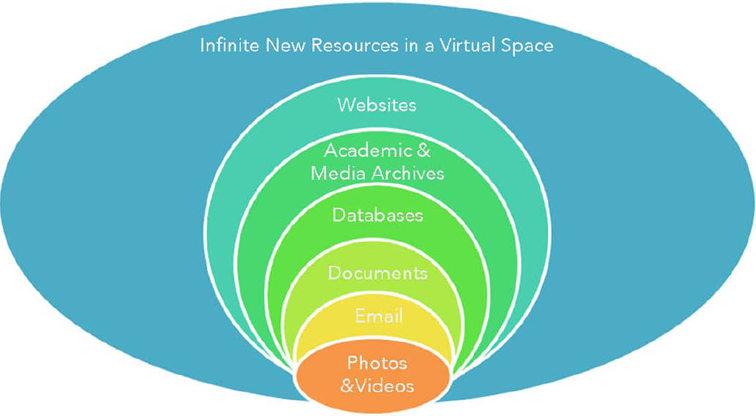
Hybrid Learning Resources
Ben-Yehuda, Levin-Banchik, and Naveh. 2015. p. 9

Slide 19
Curriculum Redesigned
Traditional learning
Students are bound to a pre-determined narrative
Materials and data are provided by educator
Hybrid learning with simulations
Students can “alter” history, as they step into decision-makers
shoes
Students create their own database for research
Ben-Yehuda, Levin-Banchik, and Naveh. 2015. pp. 10-11

Slide 20
Questions for Discussion
Who would you like to represent and why?
Would you agree to represent an enemy?
Should we replicate reality?
Is it possible to replicate reality?
What are your expectations from the simulation?

Slide 21
Key Concepts
Simulation
Players
Environment
Face-to-face simulation
Cyber simulation
Hybrid simulation
Traditional learning
Hybrid learning cycle and resources

Slide 22
Relevant Figures and Tables
Figure 1.1. Simulations and Hybrid Learning, page 4
Figure 1.2. Transformed Learning Structure, page 7
Figure 1.3. Hybrid Learning Resources, page 9
Figure 1.4. Simulations in a Hybrid Learning Cycle, page 11
Figure 1.5. Conceptual Framework: Components and Links, page 13
Table 1.1. Simulation Goals, page 6
Table 1.2. Conceptual Framework, page 12
Table 3.1. Simulation Typology, page 31
Available online at book’s website under classroom resources

